Slide 1
NLP Recurrent Neural Networks lecture 05.1
Branko Žitko
Source: DeepLearning.AI

Slide 2
Contents
Notation
Recurrent Neural Network model
Backpropagation through time
Different types of RNNs
Language model and sequence generation
Sampling novel sequences
Vanishing gradients with RNNs
Gated Recurrent Unit (GRU)
Long Short-Term Memory (LSTM) unit
Bidirectional RNN
Deep RNNs

Slide 3


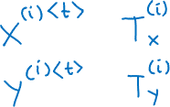
Motivating example
x: Harry Potter and Hermione Granger invented a new spell.

Slide 4
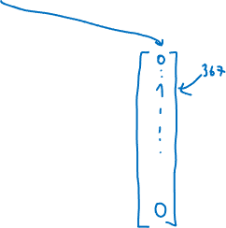
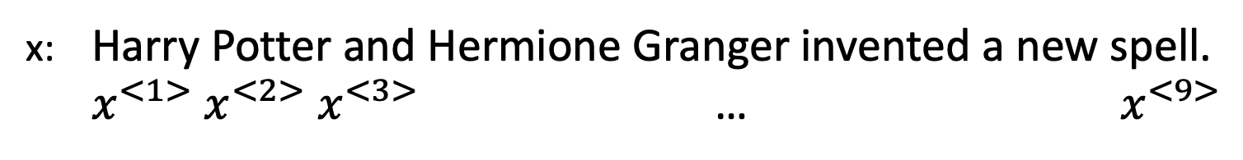

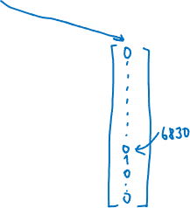


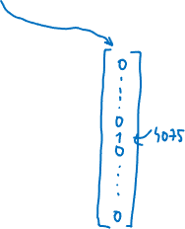
Representing words
x: Harry Potter and Hermione Granger invented a new spell.
$x^{<1>} x^{<2>}$ $x^{<3>}$ … $x^{<9>}$

Slide 5







Why not a standard network?
$$y^{<1>}$$
$$x^{<1>}$$
$$y^{<2>}$$
$$x^{<2>}$$
…
…
…
…
$$y^{<T_{y}>}$$
$$x^{<T_{x}>}$$
Problems:
Inputs, outputs can be different lengths in different examples.
Doesn’t share features learned across different positions of text.

Slide 6

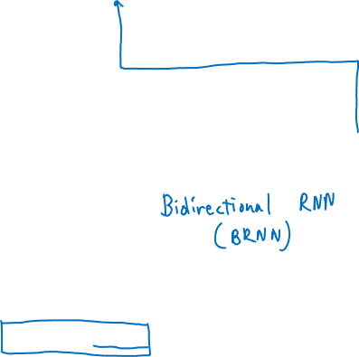



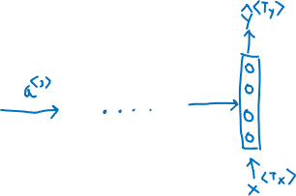


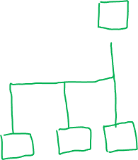
Recurrent Neural Networks
He said: "Teddy Roosevelt was a great president."
He said: "Teddy bears are on sale!"

Slide 7



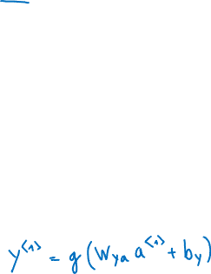




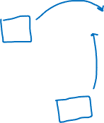






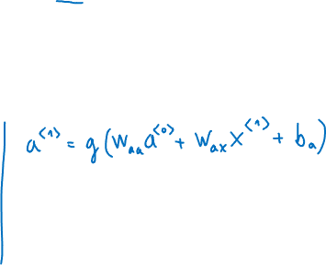




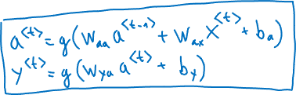
Forward Propagation
$${\hat{y}}^{<1>}$$
$${\hat{y}}^{<2>}$$
$${\hat{y}}^{<3>}$$
$${\hat{y}}^{<T_{y}>}$$
$$a^{<1>}$$
$$a^{<2>}$$
$$a^{<3>}$$
$$a^{<T_{x}−1>}$$
$$a^{<0>}$$
. . .
$$x^{<1>}$$
$$x^{<2>}$$
$$x^{<3>}$$
$$x^{<T_{x}>}$$

Slide 8


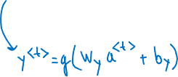


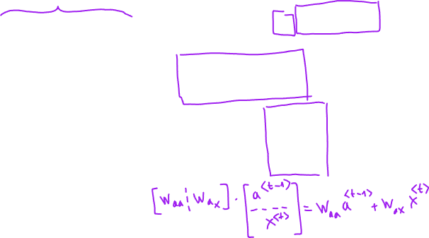
Simplified RNN notation
$$a^{<t>}=g\left(W_{aa}a^{<t−1>}+W_{ax}x^{<t>}+b_{a}\right)$$
$$y^{<t>}=g\left(W_{ya}a^{<t>}+b_{y}\right)$$

Slide 9



















Forward propagation and backward propagation
$${\hat{y}}^{<1>}$$
$${\hat{y}}^{<2>}$$
$${\hat{y}}^{<3>}$$
$${\hat{y}}^{<T_{y}>}$$
$$a^{<1>}$$
$$a^{<2>}$$
$$a^{<3>}$$
$$a^{<T_{x}−1>}$$
$$a^{<0>}$$
. . .
$$x^{<1>}$$
$$x^{<2>}$$
$$x^{<3>}$$
$$x^{<T_{x}>}$$

Slide 10



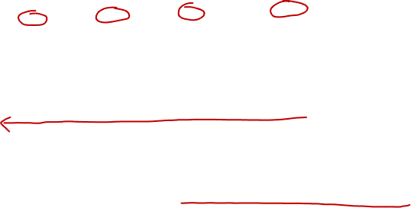



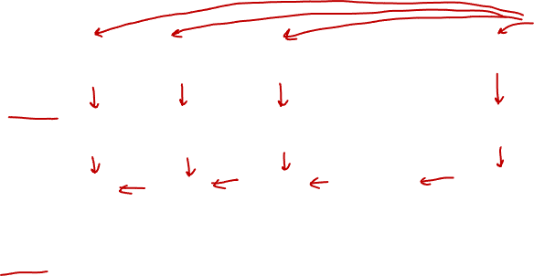


Forward propagation and backward propagation
$$ℒ^{<t>}\left({\hat{y}}^{<t>}\text{,}y^{<t>}\right)=$$
Backpropagation through time

Slide 11








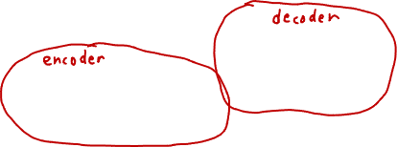

















Summary of RNN types
$${\hat{y}}^{<1>}$$
$${\hat{y}}^{<1>}$$
$${\hat{y}}^{<2>}$$
$${\hat{y}}^{<T_{y}>}$$
$$\hat{y}$$
…
$$a^{<0>}$$
…
$$a^{<0>}$$
$$a^{<0>}$$
$$x^{<1>}$$
$$x$$
$$x^{<1>}$$
$$x^{<2>}$$
$$x^{<T_{x}>}$$
One to one
One to many
Many to one
$${\hat{y}}^{<1>}$$
$${\hat{y}}^{<2>}$$
$${\hat{y}}^{<T_{y}>}$$
$${\hat{y}}^{<1>}$$
$${\hat{y}}^{<T_{y}>}$$
…
$$a^{<0>}$$
…
…
$$a^{<0>}$$
$$x^{<1>}$$
$$x^{<2>}$$
$$x^{<T_{x}>}$$
$$x^{<1>}$$
$$x^{<T_{x}>}$$
Many to many
Many to many

Slide 12



Language Modeling
Speech recognition
The apple and pair salad.
The applea and pear salad.
P(The apple and pair salad) =
P(The apple and pear salad) =

Slide 13




Language Modeling with an RNN
Training set: large corpus of text.
Cats average 15 hours of sleep a day.
The Egyptian Mau is a bread of cat. <EOS>

Slide 14



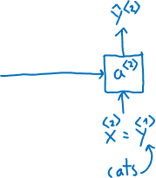
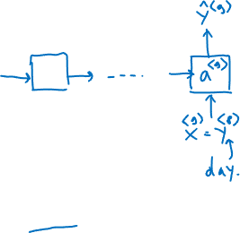
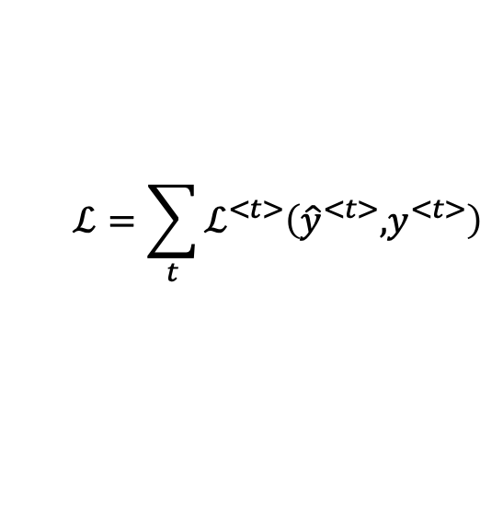


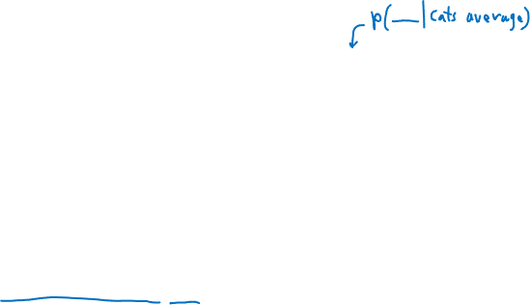
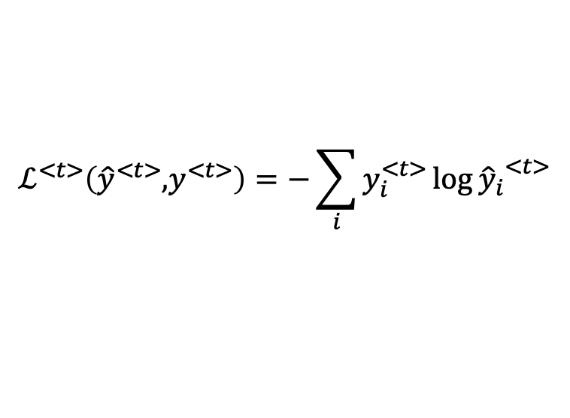
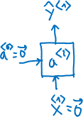
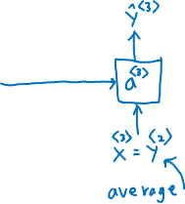

RNN model
Cats average 15 hours of sleep a day. <EOS>
$$ℒ^{<t>}\left({\hat{y}}^{<t>}\text{,}y^{<t>}\right)=−\sum_{i}{y_{i}^{<t>}\log{{{\hat{y}}_{i}}^{<t>}}}$$
$$ℒ=\sum_{t}{ℒ^{<t>}\left({\hat{y}}^{<t>}\text{,}y^{<t>}\right)}$$

Slide 15


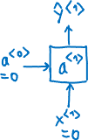





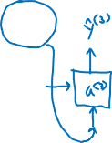




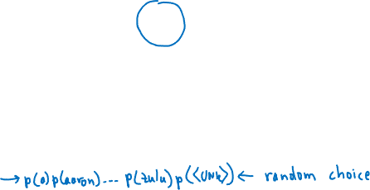


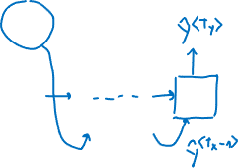



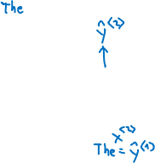


Sampling a sequence from a trained RNN
$${\hat{y}}^{<1>}$$
$${\hat{y}}^{<2>}$$
$${\hat{y}}^{<3>}$$
$${\hat{y}}^{<T_{y}>}$$
$$a^{<0>}$$
$$a^{<1>}$$
$$a^{<2>}$$
$$a^{<3>}$$
…
$$a^{<T_{y}>}$$
$$x^{<1>}$$
$$y^{<1>}$$
$$y^{<2>}$$
$$y^{<T_{x}−1>}$$

Slide 16














Character-level language model
$${\hat{y}}^{<1>}$$
$${\hat{y}}^{<2>}$$
$${\hat{y}}^{<3>}$$
$${\hat{y}}^{<T_{y}>}$$
$$a^{<0>}$$
$$a^{<1>}$$
$$a^{<2>}$$
$$a^{<3>}$$
…
$$a^{<T_{y}>}$$
$$x^{<1>}$$
$$y^{<1>}$$
$$y^{<2>}$$
$$y^{<T_{x}−1>}$$

Slide 17
Sequence generation
News
President enrique peña nieto, announced sench’s sulk former coming football langston paring.
“I was not at all surprised,” said hich langston.
“Concussion epidemic”, to be examined.
The gray football the told some and this has on the uefa icon, should money as.
Shakespeare
The mortal moon hath her eclipse in love.
And subject of this thou art another this fold.
When besser be my love to me see sabl’s.
For whose are ruse of mine eyes heaves.

Slide 18











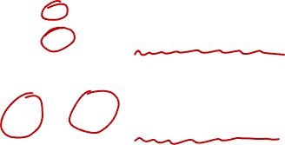


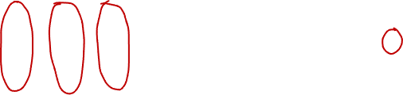


Vanishing gradients with RNNs
$${\hat{y}}^{<1>}$$
$${\hat{y}}^{<2>}$$
$${\hat{y}}^{<3>}$$
$${\hat{y}}^{<T_{y}>}$$
$$a^{<0>}$$
$$a^{<1>}$$
$$a^{<2>}$$
$$a^{<3>}$$
…
$$a^{<T_{y}>}$$
$$x^{<1>}$$
$$x^{<2>}$$
$$x^{<3>}$$
$$x^{<T_{x}>}$$
$$x$$
…
$$\hat{y}$$
Exploding gradients:

Slide 19



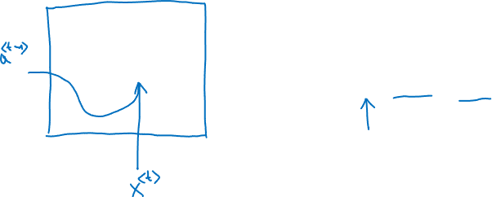
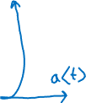
RNN unit
$$a^{<t>}=g\left(W_{a}{[a}^{<t−1>},x^{<t>}] +b_{a}\right)$$

Slide 20


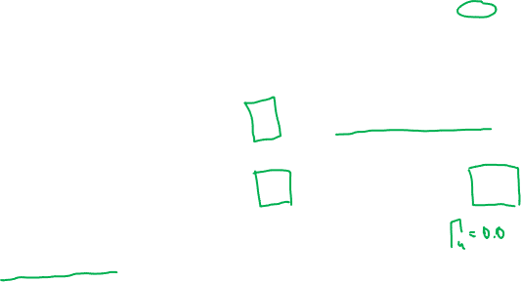
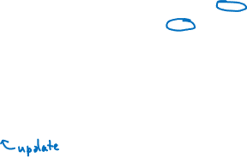





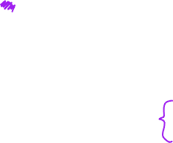
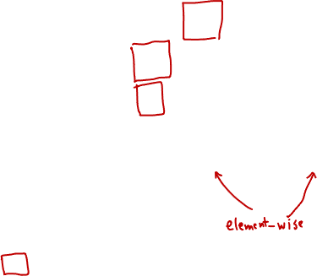
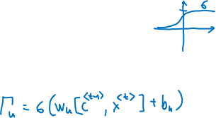


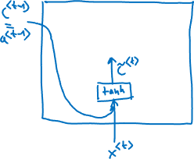


GRU (simplified)
The cat, which already ate ..., was full.
[Cho et al., 2014. On the properties of neural machine translation: Encoder-decoder approaches]
[Chung et al., 2014. Empirical Evaluation of Gated Recurrent Neural Networks on Sequence Modeling]

Slide 21

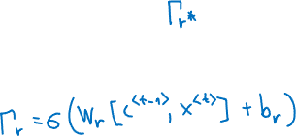



Full GRU
$${\tilde{c}}^{<t>}=\tanh\left(W_{c}{[ c}^{<t−1>},x^{<t>}] +b_{c}\right)$$
$$Γ_{u}=σ\left(W_{u}{[c}^{<t−1>},x^{<t>}] +b_{u}\right)$$
$$c^{<t>}=Γ_{u}{∗\tilde{c}}^{<t>}+\left(1−Γ_{u}\right)∗c^{<t−1>}$$
The cat, which already ate, was full.

Slide 22
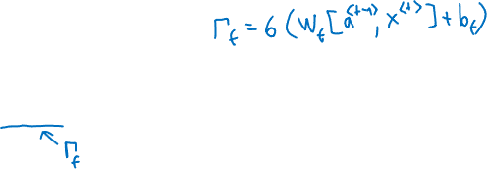




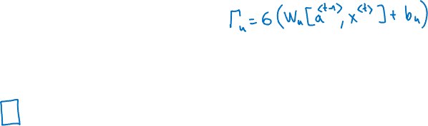

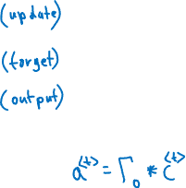

GRU and LSTM
GRU
LSTM
$${\tilde{c}}^{<t>}=\tanh\left(W_{c}{[Γ_{r}∗c}^{<t−1>},x^{<t>}] +b_{c}\right)$$
$$Γ_{u}=σ\left(W_{u}{[c}^{<t−1>},x^{<t>}] +b_{u}\right)$$
$$Γ_{r}=σ\left(W_{r}{[c}^{<t−1>},x^{<t>}] +b_{r}\right)$$
$$c^{<t>}=Γ_{u}{∗\tilde{c}}^{<t>}+\left(1−Γ_{u}\right)∗c^{<t−1>}$$
$$a^{<t>}=c^{<t>}$$
[Hochreiter & Schmidhuber 1997. Long short-term memory]

Slide 23






GRU and LSTM
GRU
LSTM
$${\tilde{c}}^{<t>}=\tanh\left(W_{c}{[Γ_{r}∗c}^{<t−1>},x^{<t>}] +b_{c}\right)$$
$${\tilde{c}}^{<t>}=\tanh\left(W_{c}{[a}^{<t−1>},x^{<t>}] +b_{c}\right)$$
$$Γ_{u}=σ\left(W_{u}{[c}^{<t−1>},x^{<t>}] +b_{u}\right)$$
$$Γ_{u}=σ\left(W_{u}{[a}^{<t−1>},x^{<t>}] +b_{u}\right)$$
$$Γ_{f}=σ\left(W_{f}{[a}^{<t−1>},x^{<t>}] +b_{f}\right)$$
$$Γ_{r}=σ\left(W_{r}{[c}^{<t−1>},x^{<t>}] +b_{r}\right)$$
$$Γ_{o}=σ\left(W_{o}{[a}^{<t−1>},x^{<t>}] +b_{o}\right)$$
$$c^{<t>}=Γ_{u}{∗\tilde{c}}^{<t>}+\left(1−Γ_{u}\right)∗c^{<t−1>}$$
$$c^{<t>}=Γ_{u}{∗\tilde{c}}^{<t>}+Γ_{f}∗c^{<t−1>}$$
$$a^{<t>}=c^{<t>}$$
$$a^{<t>}={Γ_{o}∗c}^{<t>}$$
[Hochreiter & Schmidhuber 1997. Long short-term memory]

Slide 24



























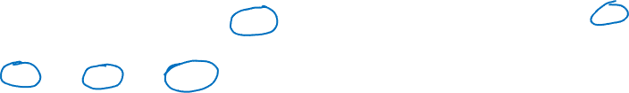

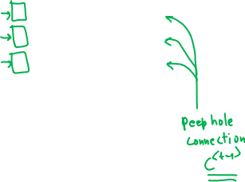






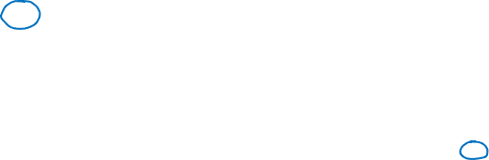

LSTM in pictures
$$y^{<t>}$$
$${\tilde{c}}^{<t>}=\tanh\left(W_{c}{[a}^{<t−1>},x^{<t>}] +b_{c}\right)$$
softmax
$$Γ_{u}=σ\left(W_{u}{[a}^{<t−1>},x^{<t>}] +b_{u}\right)$$
$$a^{<t>}$$
$$Γ_{f}=σ\left(W_{f}{[a}^{<t−1>},x^{<t>}] +b_{f}\right)$$
$$c^{<t>}$$
$$c^{<t>}$$
$$c^{<t−1>}$$
*
+
$$Γ_{o}=σ\left(W_{o}{[a}^{<t−1>},x^{<t>}] +b_{o}\right)$$
tanh
$$c^{<t>}=Γ_{u}{∗\tilde{c}}^{<t>}+Γ_{f}∗c^{<t−1>}$$
*
$$a^{<t>}$$
$$a^{<t>}$$
$$a^{<t−1>}$$
*
$$f^{<t>}$$
$$i^{<t>}$$
$${\tilde{c}}^{<t>}$$
$$o^{<t>}$$
$$a^{<t>}=Γ_{o}∗\tanh{c^{<t>}}$$
forget gate
update gate
tanh
output gate
$$x^{<t>}$$
$$y^{<1>}$$
$$y^{<2>}$$
$$y^{<3>}$$
softmax
$$c^{<1>}$$
softmax
$$c^{<2>}$$
softmax
$$c^{<3>}$$
$$c^{<0>}$$
*
+
*
+
*
+
tanh
*
tanh
*
tanh
$$a^{<0>}$$
*
*
$$a^{<1>}$$
*
$$a^{<2>}$$
*
$$a^{<3>}$$
tanh
tanh
tanh
$$x^{<1>}$$
$$x^{<2>}$$
$$x^{<3>}$$

Slide 25



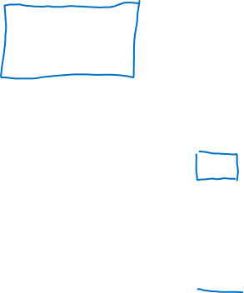




















Getting information from the future
He said: "Teddy Roosevelt was a great president."
He said: "Teddy bears are on sale!"
$${\hat{y}}^{<1>}$$
$${\hat{y}}^{<2>}$$
$${\hat{y}}^{<3>}$$
$${\hat{y}}^{<4>}$$
$${\hat{y}}^{<5>}$$
$${\hat{y}}^{<6>}$$
$${\hat{y}}^{<7>}$$
$$a^{<0>}$$
$$a^{<1>}$$
$$a^{<2>}$$
$$a^{<3>}$$
$$a^{<4>}$$
$$a^{<5>}$$
$$a^{<6>}$$
$$a^{<7>}$$
$$x^{<1>}$$
$$x^{<2>}$$
$$x^{<3>}$$
$$x^{<4>}$$
$$x^{<5>}$$
$$x^{<6>}$$
$$x^{<7>}$$
He
said,
"Teddy
bears
are
on
sale!"

Slide 26
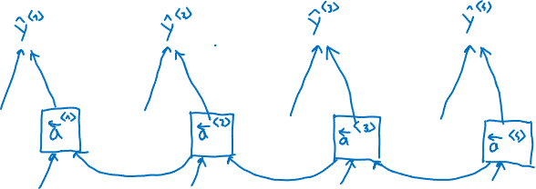






Bidirectional RNN (BRNN)

Slide 27

























Deep RNN
$${\hat{y}}^{<1>}$$
$${\hat{y}}^{<2>}$$
$${\hat{y}}^{<3>}$$
$${\hat{y}}^{<4>}$$
$$a^{[3]<0>}$$
$$a^{[3]<1>}$$
$$a^{[3]<2>}$$
$$a^{[3]<3>}$$
$$a^{[3]<4>}$$
$$a^{[2]<0>}$$
$$a^{[2]<1>}$$
$$a^{[2]<2>}$$
$$a^{[2]<3>}$$
$$a^{[2]<4>}$$
$$a^{[1]<0>}$$
$$x^{<1>}$$
$$x^{<2>}$$
$$x^{<3>}$$
$$x^{<4>}$$

